Slide 1
MEDB 5510 Clinical Research Methods
Week 5
Research Approaches / Designs
Randomized Exp & Quasi-Exp
Notes:
Homework

Slide 2
Research Approaches
2
Notes:
[

Slide 3
Research Approaches
3
Notes:
[

Slide 4
Research Approaches
Randomized Experimental
Criteria
Random assignment
Active independent variable
(Experimenter control of active independent variable)
What is “treatment”
When it will be given
Who it will be given to

Slide 5
Research Approaches
Randomized Experimental
Importance of random assignment
Bias
Equivalence of groups before treatment
Random selection (sampling)
What does this mean?
How does it relate to random assignment?
Value of random selection?

Slide 6
Research Approaches
Quasi-Experimental
What criteria of Experimental not met?
Categories of Q-E approach
Q-E with major limitations
Pretest-Posttest designs
Time-series designs
Single-subject designs

Slide 7
Research Approaches
7
Notes:
[

Slide 8
Randomized Experimental and Q-E Designs

Slide 9
Quasi-Experimental Designs
Categories of Q-E approach
Q-E with major limitations
Pretest-Posttest designs
Time-series designs
Single-subject designs

Slide 10
Quasi-Experimental Designs
Q-E with major limitations
Also called Pre-experimental
One-Group Posttest-Only
NR E: X O

Slide 11
Quasi-Experimental Designs
Q-E with major limitations
Also called Pre-experimental
One-Group Pretest-Posttest
NR E: O1 X O2
Improvement - Wait-List Comparison Group
Immediate Group O1 X O2
Wait-List Group O1 ~X O2 X O3

Slide 12
Quasi-Experimental Designs
Q-E with major limitations
Also called Pre-experimental
Posttest-Only Nonequivalent Groups
NR E: X O
NR C: ~X O

Slide 13
Quasi-Experimental Designs
Better Q-E Designs
Pretest-Posttest Nonequivalent Comparison Group
NR E: O1 X O2
NR C: O1 ~X O2
3 strengths based on
How participants got into the groups/conditions
How much control investigator has over IV
Strong
Moderate-strength
Weak

Slide 14
Quasi-Experimental Designs
Better Q-E Designs
Single-Group Time-Series
Characteristics
Temporary treatment vs Continuous treatment
Multi-Group Time-Series
Characteristics
Temporary treatment vs Continuous treatment

Slide 15
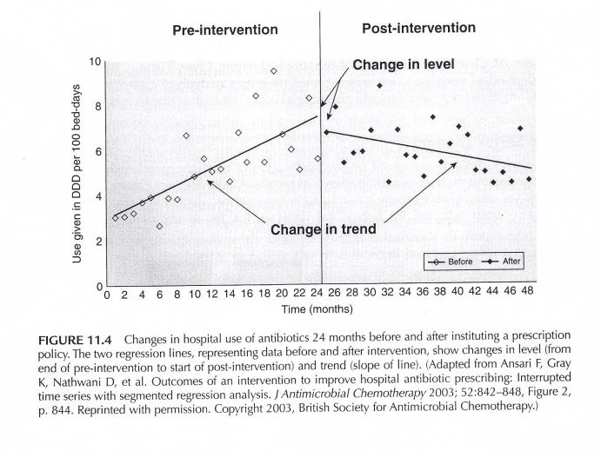
Q-E Time Series Designs
Portney & Watkins, 2009

Slide 16
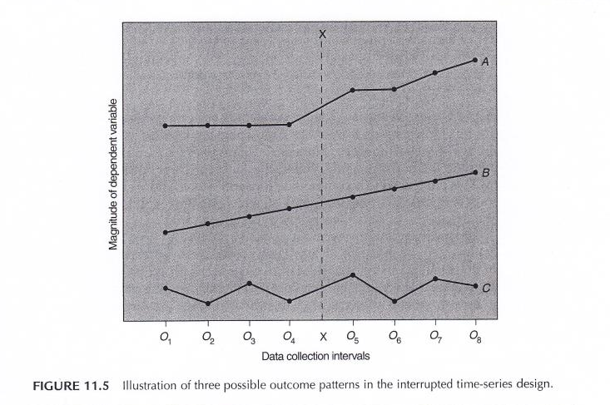
Q-E Time Series Designs
Portney & Watkins, 2009

Slide 17
Quasi-Experimental Designs
Typical examples of Q-E designs
Case-control study
Cohort study
Non-equivalent control group design
Interrupted time-series design
Single system design

Slide 18
Randomized Experimental Designs
Characteristics
Assignment
Type of IV
Control of IV
Purpose

Slide 19
Randomized Experimental Designs
Posttest-Only Control Group
R E: X O
R C: X O
Strengths
Weaknesses

Slide 20
Randomized Experimental Designs
Pretest-Posttest Control Group
R E: O1 X O2
R C: O1 ~X O2
Strengths
Weaknesses

Slide 21
Randomized Experimental Designs
Solomon Four-Group
R E1: O1 X O2
R E2: X O2
R C1: O1 ~X O2
R C2: ~X O2
Strengths
Weaknesses

Slide 22
Randomized Experimental Designs
Randomized Experimental Design with Matching
M R E: X O
M R C: ~X O
Strengths
Weaknesses

Slide 23
Randomized Experimental Designs
Within-Subjects Randomized Experimental (Crossover) Design
R Order 1 X O1 ~X O2
R Order 2 ~X O1 X O2
Strengths
Weaknesses

Slide 24
Randomized Experimental and Q-E Designs

Slide 25
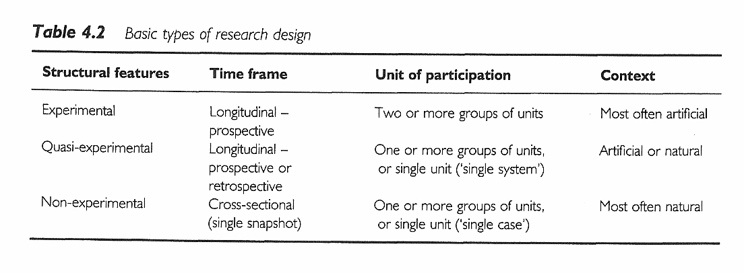
Research Design
Sim & Wright. Research in Health Care. 2000. Table 4.2
25

Slide 26
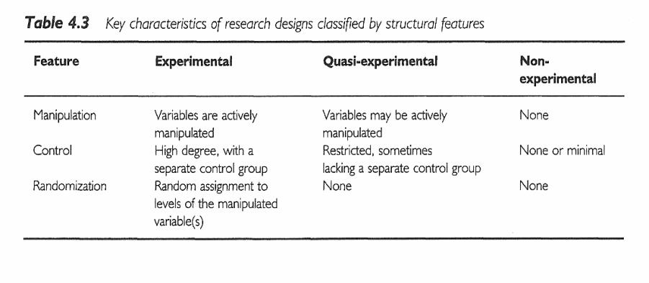
Research Design
Sim & Wright. Research in Health Care. 2000. Table 4.3
26

Slide 27
Assignment #3
Prepare a brief description of the topic you are planning to focus on for your research proposal. (Introduction)

